Slide 1
Super Automatic Espresso Machine
University of Utah
Senior Capstone
Nathan Donaldson
Ben Nagel Aaron Pabst
Elliot Carr-Lee

Slide 2
Overview
Our Machine aims to
Bring personalization and automation into making coffee
Be fully automatic, with minimal user interaction or cleaning
Have a simple Android UI
Use gathered data to offer users more options.

Slide 3
Introduction
Current Market
Semi-Automatic Machines
Requires outside skills to complete
As precise as the maker cares to be
Why Our Project?
Fast and Easy for the average consumer
Reduced User Interaction
Precision and Repeatability

Slide 4
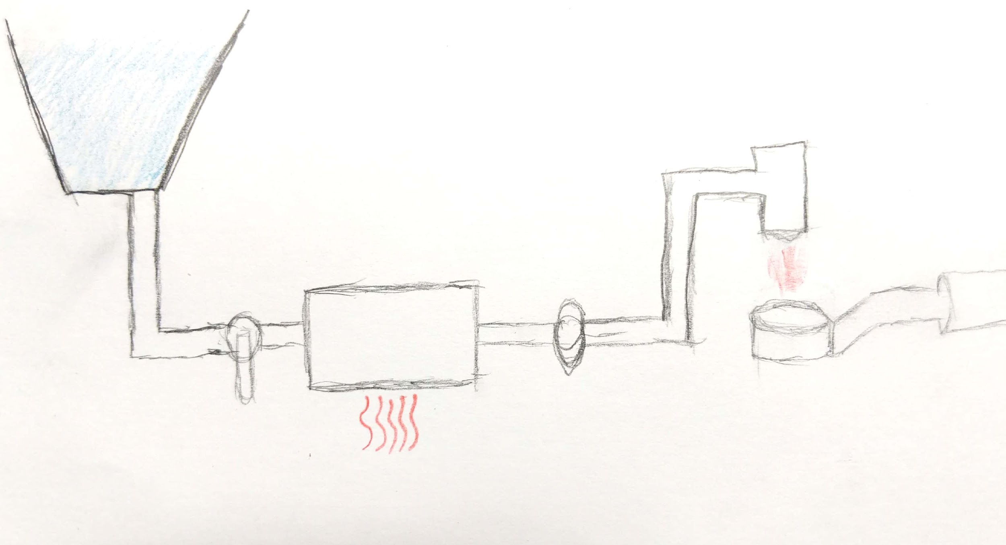
How Espresso Machines work
Storage Tank
Valve
Boiler
Pump
Espresso Puck

Slide 5
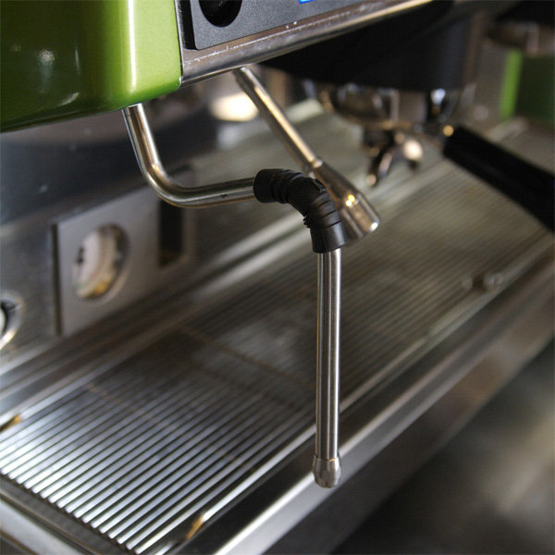
How Espresso Machines work
Storage Tank
https://www.espressoparts.com/EspressoEquipmentLingo

Slide 6
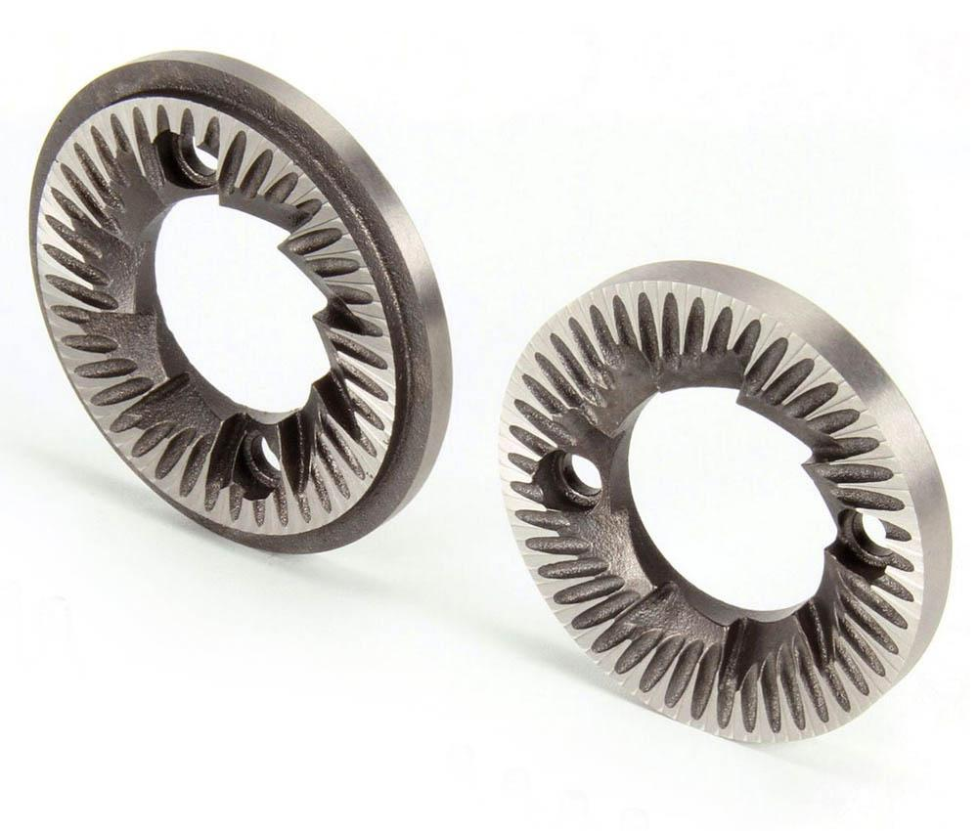
How Espresso Machines work
https://www.toomerscoffee.com/burr-grinders-are-best-for-great-tasting-coffee/

Slide 7
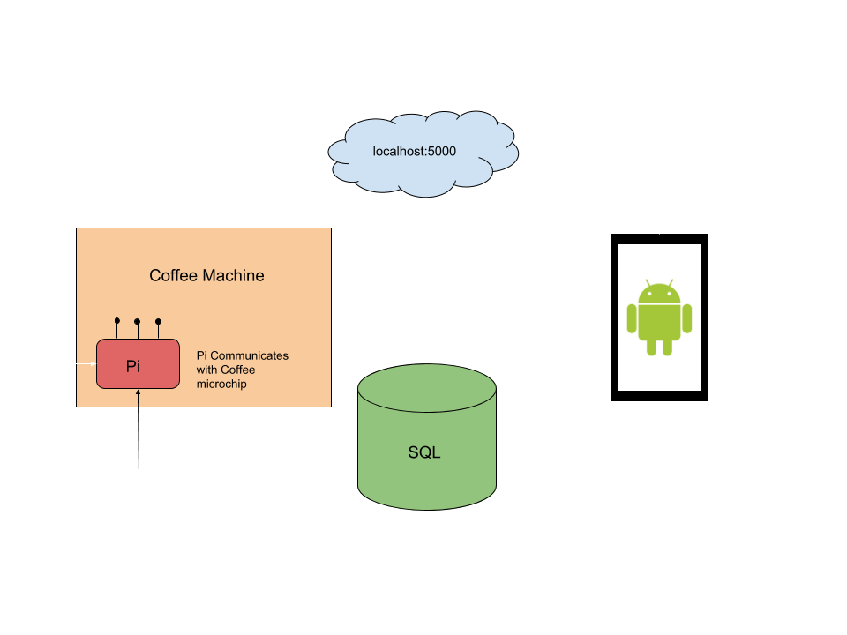
Project Overview

Slide 8
Flask
Flask is a Python MicroFramework that assists in the creation of websites.
We will be using it as a REST server that is running on a Raspberry Pi.
This Provides us with
Access from anyone on the network
Reliability through HTTP
Acts as a middleman between the Android Phone and the microcontroller

Slide 9
Materials
Raspberry Pi
Custom PCBs
Copper Pipe
PLA Plastic
Peltier Heating / Cooling Elements
Servos
Stepper Motors
Peristaltic Pumps
Thermocouples
Liquid Pressure Sensors

Slide 10
Testing
Four Main Testing Operations:
Mechanical Component Testing
Make sure we’re not building a bomb
Server Testing
Make sure we are receiving and processing ‘real’ requests
Android UI Testing
Make sure we are sending the right commands out
Database Testing
Make sure we are collecting, reporting and suggesting the correct data

Slide 11
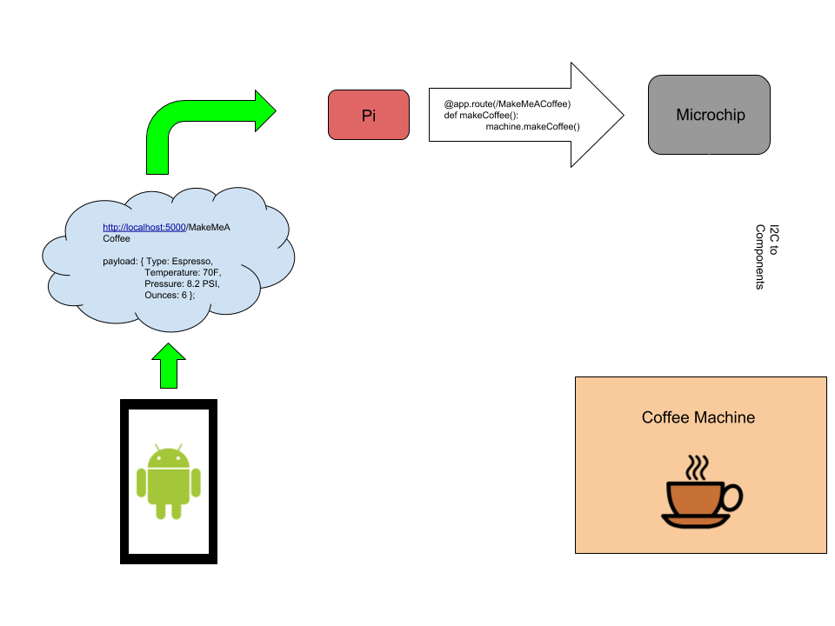
Demonstration
At the project demonstration, the machine will be setup with an Android tablet and loaded with ingredients.
Visitors will be invited to use the tablet to create a drink of their choosing, demonstrating varying selection possibilities.

